Slide 1

Project- INFO 6210 Data Management and Database Design
JOB DATABASE
Progress Report
By : Harshita Gupta
Ritvik Chauhan

Slide 2
Job Database Project Idea:
The goal of this project is to have a list of at least 1500 companies with their website and media pages links for domains such as Finance, Health Care, Digital Marketing, Engineering – Computer vision and E-commerce. Apart from that, we will also have the list of relevant skills required for a domain.

Slide 3
Following are the requirements for the project
To Create a list of 300/450 companies with their website and media page links.
To Create a robot which extracts data from their website and media pages for one company.
To Generalize the code which can run for all the companies or for most of the companies.
Manually change the links for remaining companies to extract the data.
To Create a word cloud for the most relevant skills for a domain.

Slide 4
What we have done ….
We have explored the different job portals available and researched about the different domains for jobs. Also searched about the skill set required for specific domains and viewed some articles regarding job database.

Slide 5
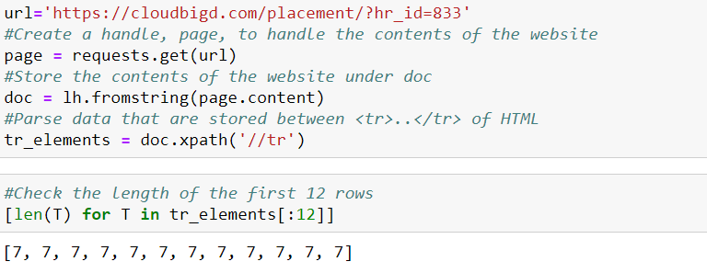
We collected job data by scraping data from different job platforms for different domain and assembling it together. .

Slide 6
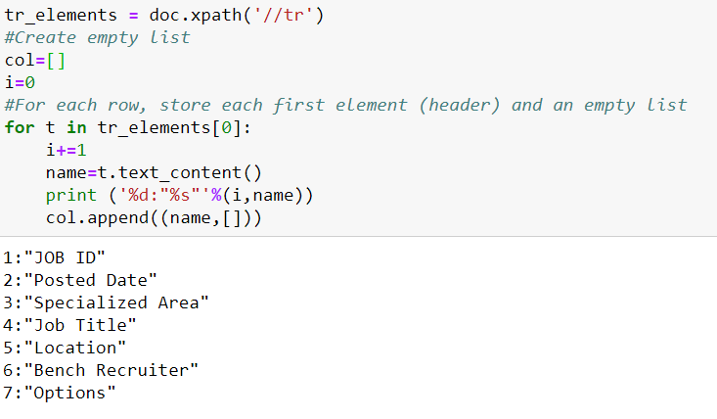

Slide 7
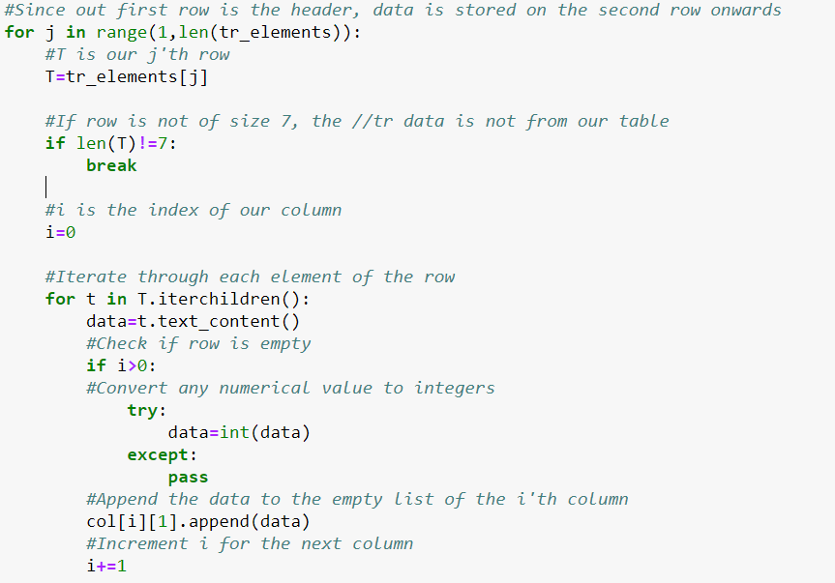

Slide 8
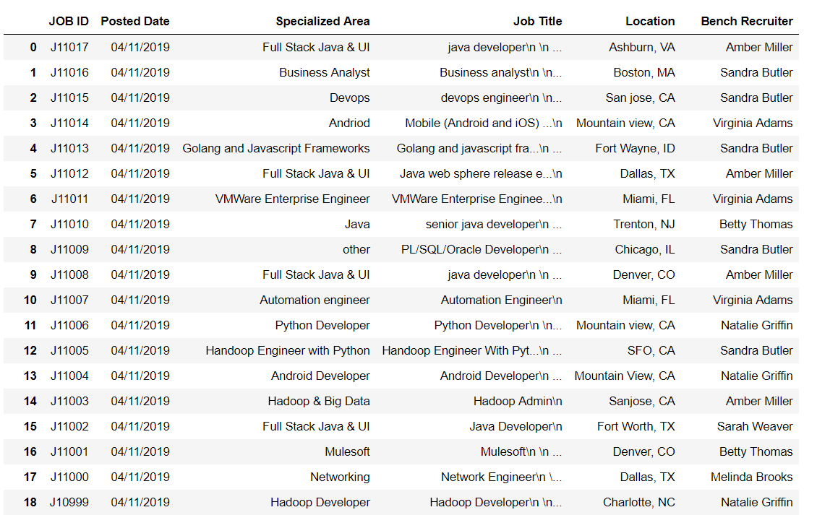
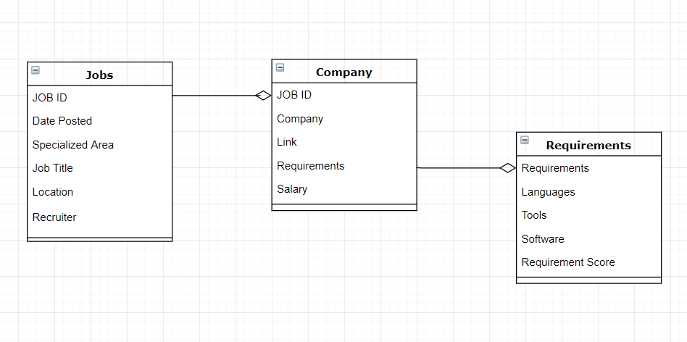

Slide 9
What we will be doing next…
Till we have scraped the data for different Jobs at one place
Normalization and grouping of the companies according to different domain,
skills, technologies and requirements for position
Next we will be Scrapping the requirements and information about the job from individual Companies
We will automate this process
On the basis of job requirements, we will rate the jobs on a scale of 1 to 5,
where 1 being Entry Level Job while 5 being Senior Level Job
On the basis of skill set we will be predicting the chances of landing an interview.

Slide 10

Thank you!

